Slide 1


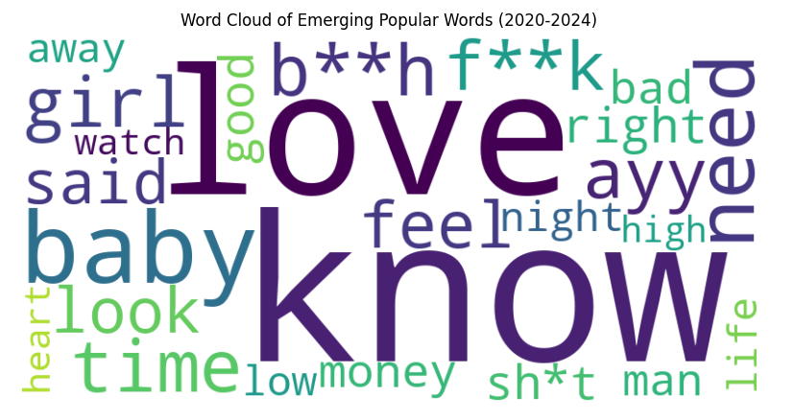
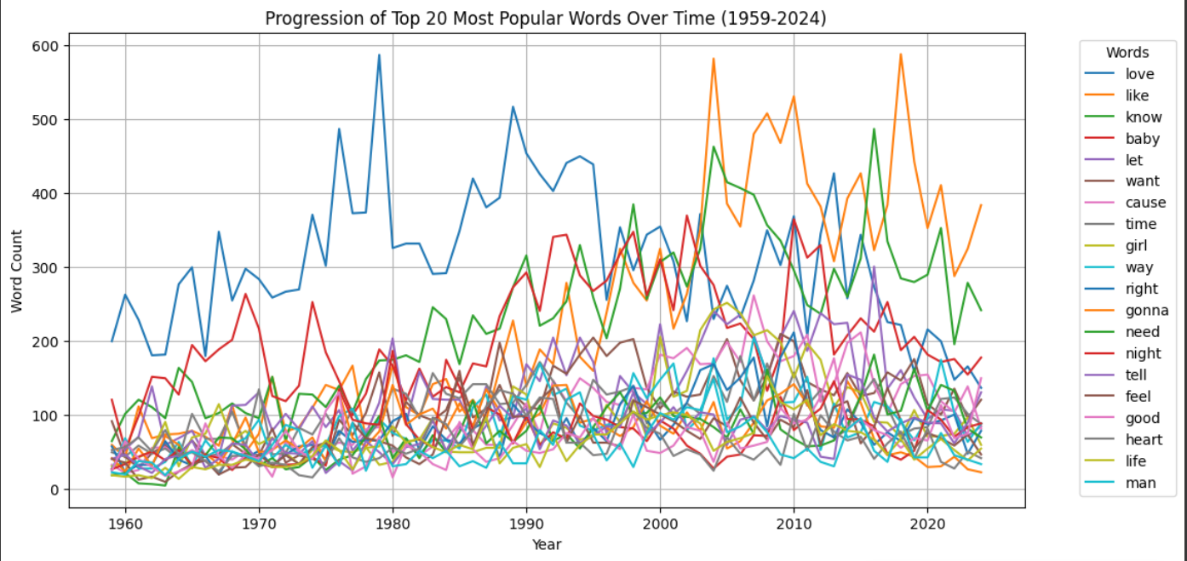
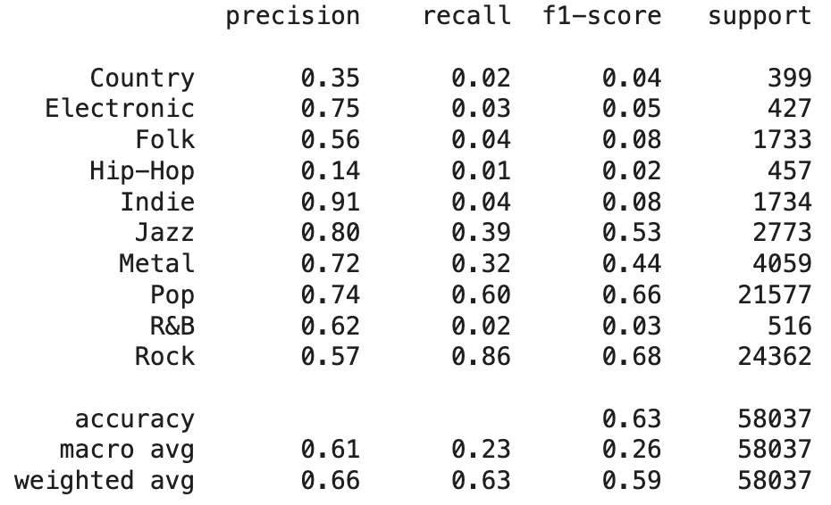
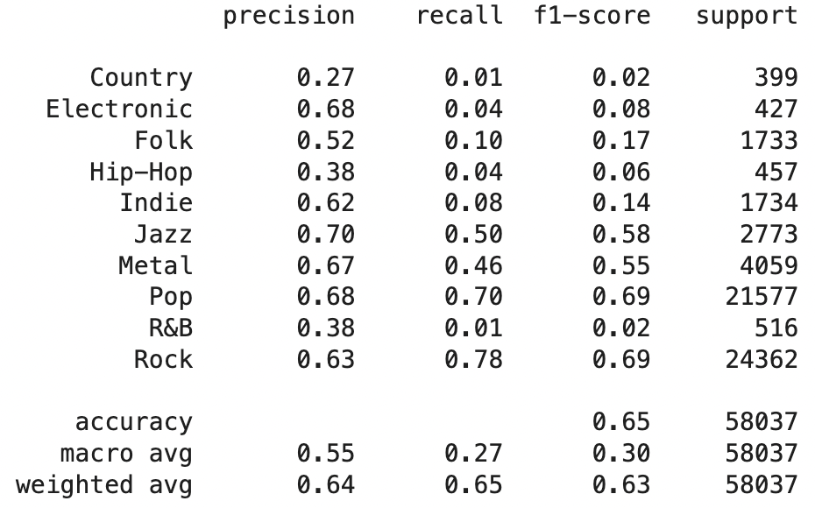

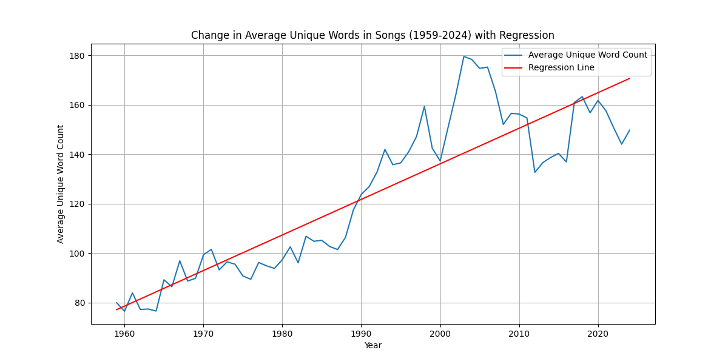
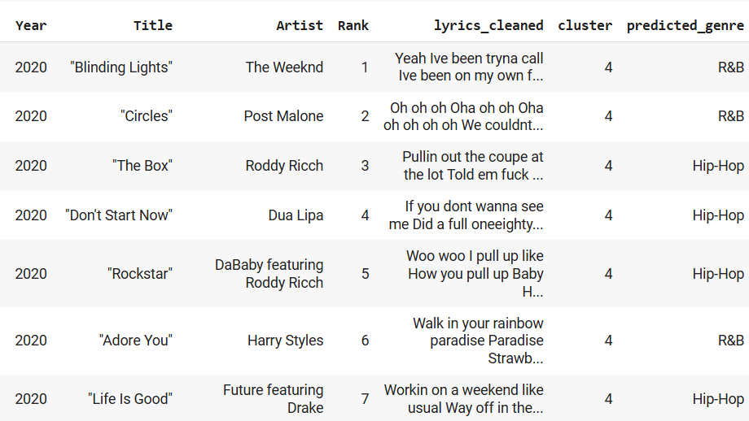
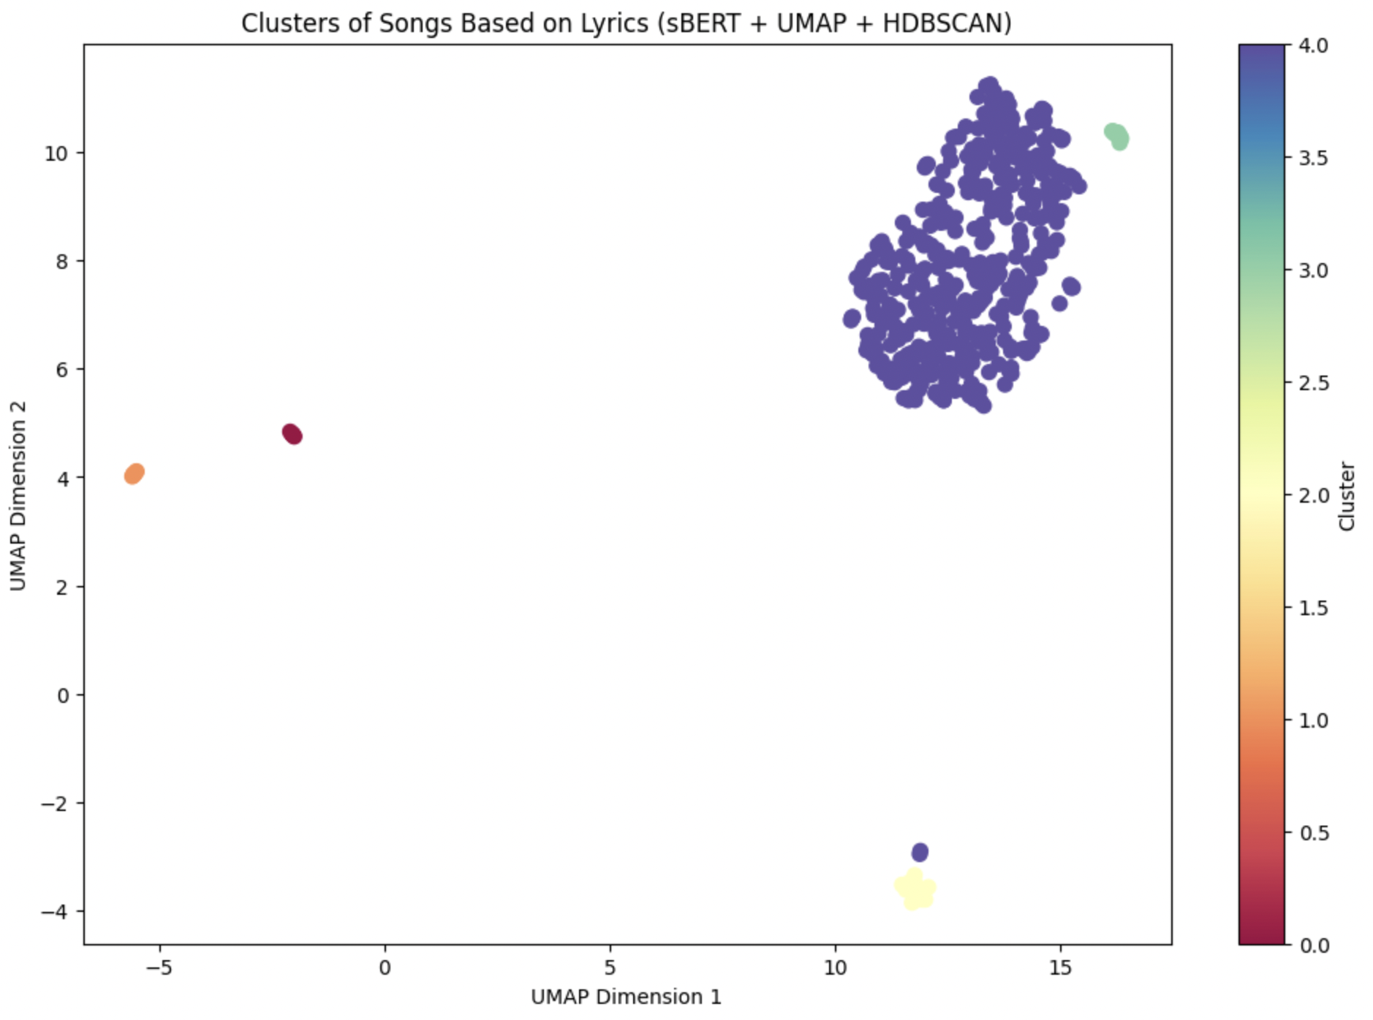
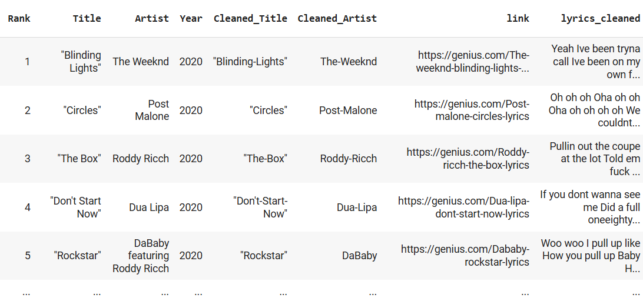
Lyrics-Based Genre Classification: Insights from Modern NLP and Machine Learning
Rydham Goyal, Zihan Wang Datasci 112 Winter 2025
Abstract
Data Exploration
Data Analysis - Machine Learning
While genre classification can be done using acoustic features (e.g., tempo, rhythm, timbre) lyrics-based classification is an alternative lens to understand genre and its evolution, since lyrics capture an artist’s narrative themes, style, and cultural messaging. Current methods that demonstrated moderate success in using tf-idf and machine learning techniques on lyrics inspired us to build on their work, integrating modern NLP techniques and custom datasets.
Rise in Explicit Language (figure 1)
Word clouds (2020-2024) show increased profanity (“fk,” “sh*t,” “bh”), reflecting cultural shifts and audience acceptance.
Common Words in Viral Songs (figure 2)
“love,” “baby,” “like” remain dominant.
Emerging slang (“ayy,” “cause”) indicates evolving lyrical trends.
Growing Lyrical Diversity (figure 3)
Unique word count steadily increases (1959-2024), suggesting richer vocabulary and deeper storytelling.
Shifting Popular Words (2015-2024)
Words like “look,” “life,” “said” remain constant.
Others (“gonna,” “hit,” “lil”) have surged, shaping modern song narratives.
Supervised Learning vs Cosine Similarity: Machine learning models had very low accuracy, precision, recall, and F-1 scores. This tells us tha lyrics alone aren’t sufficient for accurate genre classification (since approach was based on lyrical similarity).
Key insight:
music genre is based on auditory features (melody, rhythm) which are not captured by lyrics. While lyrics reflect thematic elements, sound information is required for accurate genre prediction.
Cosine similarity based comparison (figure 4) outperformed machine learning models (LinearSVC, Multinomial Naive Bayes, XGBoost). We grouped labeled data by genre and used cosine similarity to compare unlabeled songs to these genre groups, assigning a genre based on highest average cosine similarity score to a group. Imbalance in genre representation in labeled dataset (example: ‘Country’ & ‘Electronic’ had precision 1.00 but recall 0.00, meaning the classifiers rarely, if ever, predicted these genres, but when predictions were correct when they did). Cosine similarity had no learned parameters, rather direct similarity comparison, leading to better outcomes.
Unsupervised learning (clustering): We tested clustering to group unlabeled songs based on lyrical similarity metric. Approach: we generated Sentence-BERT embeddings for the song lyrics and reduced their dimensionality with UMAP, then applied HDBSCAN to identify clusters of lyrically similar songs.
Optimized Result: five distinct clusters
corresponding to train data, with one
large dominant cluster encompassing
the majority of the songs (songs with
common lyrical themes or stylistic
elements, corresponding to
mainstream genres like ‘Pop’ or ‘Rock’,
that often dominate popular music
charts). Conversely, smaller, well-separated clusters represent songs with more unique or niche lyrical content (‘Jazz’, ‘Country’, or ‘Electronic’). Results suggest that combination of semantic embeddings and density-based clustering effectively captures differences in lyrical themes across songs. However, dominance of a single cluster confirms imbalance in dataset, where certain genres or lyrical styles are overrepresented, influencing the clustering outcome (explains why cosine similarity outperformed ML models).
Figure 1
XGBoost
LinearSVC
Multinomial Naive Bayes
Research Question
Objective: evaluate lyricism as a classification metric and analyse music trends (BillBoard Top 100 songs).
"How have song lyrics changed over the years among top-ranked songs?" and "Can we analyze lyrical content to predict a song’s genre, and use that to study trends when explicit genre data isn’t available?"
Figure 2
Figure 3
Data Collection
Billboard Data via Web Scraping
BeautifulSoup: Rank, Title, and Artist from Wikipedia
Cleaning: Removed special characters, keep explicit words
Rate Limiting: Used (time.sleep(0.5)) to prevent website overload
Cleaned Complete Top Songs Dataset (1959-2024)
Figure 4
Conclusion
Lyrics via Genius API
Queried: Genius API with cleaned song titles and artist names
Extracted: Song IDs, URLs, and lyrics
Handled Missing Data: Assigned None unmatched entries
Lyrics offer limited accuracy for genre classification. Unsupervised clustering revealed distinct lyrical patterns but also highlighted the dominance of mainstream genres in popular music. Lyrics can provide insights into genre trends, but combining lyrical and audio features would lead to more accurate and meaningful classification, a possible theme for next exploration.

